Slide 1
Document Databases

Slide 2
NoSQL: Document Store
Database is a collection of "documents"
  Structured format: JSON, XML
Collection ↔ Table
Document ↔ Row of Table
Every document can have its own structure
  Different attributes, complex values
  Usually documents in a collection have (somewhat) consistent keys
Query for documents using their keys

Slide 3
XML Document
<artist>
<artistname>Iron Maiden</<artistname>
<albums>
<album>
<albumname>The Book of Souls</albumname>
<datereleased>2015</datereleased>
<genre>Hard Rock</genre>
</album>
<album>
<albumname>Killers</albumname>
<datereleased>1981</datereleased>
<genre>Hard Rock</genre>
</album>
<album>
<albumname>Powerslave</albumname>
<datereleased>1984</datereleased>
<genre>Hard Rock</genre>
</album>
<album>
<albumname>Somewhere in Time</albumname>
<datereleased>1986</datereleased>
<genre>Hard Rock</genre>
</album>
</albums>
</artist>

Slide 4
JSON Document
{
"artistName" : "Iron Maiden",
"albums" : [
{
"albumname" : "The Book of Souls",
"datereleased" : 2015,
"genre" : "Hard Rock"
}, {
"albumname" : "Killers",
"datereleased" : 1981,
"genre" : "Hard Rock"
}, {
"albumname" : "Powerslave",
"datereleased" : 1984,
"genre" : "Hard Rock"
}, {
"albumname" : "Somewhere in Time",
"datereleased" : 1986,
"genre" : "Hard Rock"
}
]
}

Slide 5
JSON Syntax
Dictionaries
  { <key₁>: <value₁>, … ,<key₂>: <value₂> }
Lists
  [ <value₁>, …, <value_{n}> ]
Strings, Numbers, Boolean, Null
  "string", 1, 5.6, true, null
White-space is ignored
  Newlines, spaces, tabs
Maps directly to modern programming lang.

Slide 6
Why Document Stores
Documents can be partitioned across many commodity compute nodes
Query requests sent to each compute node, executed in parallel on data partition
Writes can be executed against any convenient node and in parallel
Data can be replicated for performance and robustness reasons
Flexible attributes can be determined later

Slide 7
Why Not Document Stores
No complex relational queries
Complex values can't be readily indexed.
Inconsistent keys can make the application logic convoluted
Flexible data-model can lead to ad-hoc and on-the-fly modeling decisions
  Logical data-model is still needed, even if only "on paper," for application success

Slide 8
Document DBs and Key-Value Stores
Document databases are an evolutionary step from Key-Value stores
  Added structure
  Added functionality based on that structure
Like relational tables, Document DBs organize related attributes into a single object
  Key-Value database may have many keys and key lookups
Query language is more expressive
  Because of defined structure, DB can look into the document
Still have flexibility in the design of the data
  Each document can be different

Slide 9
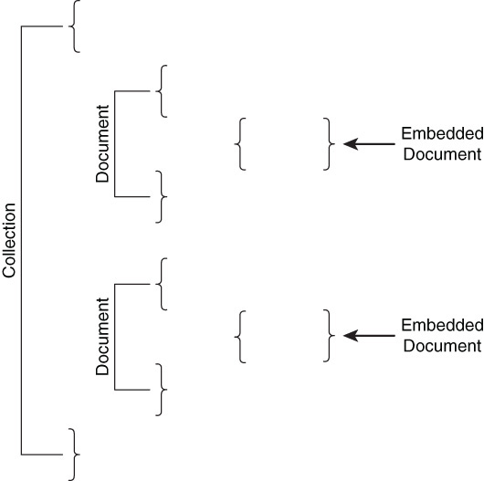
Embedded Documents
Documents within documents
Store data that is frequently used together
Store relationships within the document
Can eliminate joins

Slide 10
Schemaless
Document databases do not require data modelers to formally specify the structure of documents.
No specification of structure is required
With great power comes great responsibility
Schemaless databases are something of a double-edged sword
  the flexibility of working without a schema makes it easy to accommodate differences in document structures.
  the document database management cannot enforce rules based on structure. Because there is no way to indicate that a key-value pair should always exist in a document, the document database management system will not check for it.
If the database management system does not enforce rules about data, what will? The answer is your application code.

Slide 11
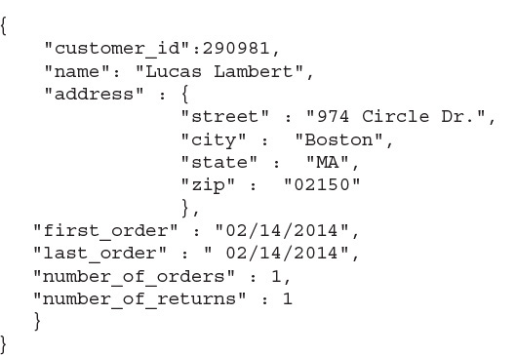
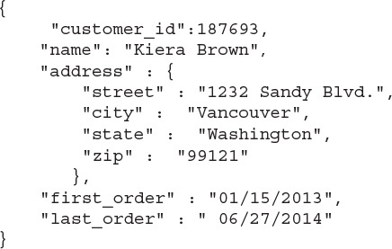
Collections
Sets of similar documents
  Share common structure – doesn’t have to be all the same
  Should store documents about the same type of entity

Slide 12
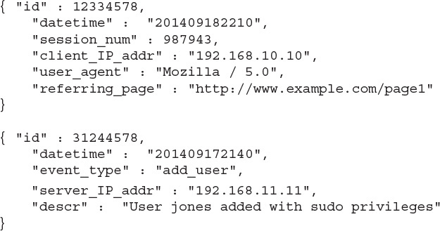
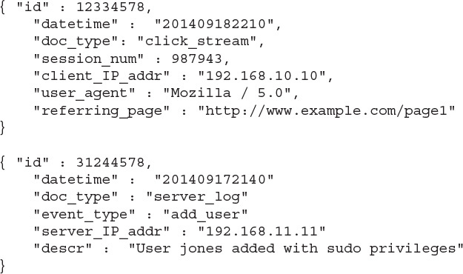
Collections
Can be very flexible, but…
  If documents are too dissimilar, it makes it difficult to search
  Probably end up adding a type field → put them in a different collection

Slide 13
Collections
Avoid overly abstract document types. If you find yourself writing separate code to process different document subtypes, you should consider separating the types into different collections. Poor collection design can adversely affect performance and slow your application. There are cases where it makes sense to group somewhat dissimilar objects (for example, small kitchen appliances and books) if they are treated as similar (for example, they are all products) in your application.
But…
Document databases are designed to accommodate variations in documents within a collection. Because any document could be different from all previously inserted documents, it does not make sense to require data modelers to specify all possible document fields prior to building and populating the database. This freedom from the need to predefine the database structure is captured in the term often used to describe document databases: schemaless.

Slide 14
Normalization vs Denormalization
Normalization vs Denormalization
Normalization is all about eliminating redundancy which can cause anomalies
Normalization may reduce performance
  Separates data → requires joins
Denormalization keeps data together
  Example: A contact and all their phone numbers
Denormalization can reduce lookups
  All in the same document

Slide 15
Denormalization
Keep data that is frequently used together in the same document
But be careful!
  Don’t want to allow too much extraneous data to creep into your documents
Let your queries be your guide!
Joins are generally not supported, but you can write programs that essentially do the joins
  Expensive
  Consider putting the data in the document – even if it may be duplicated data
    Be careful

Slide 16
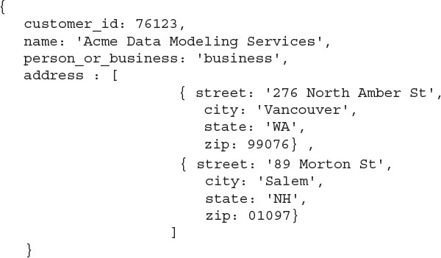
One to Many Relations
Document embedding
The “one” entity is the primary document
The “many” entities are embedded
Be aware of ”how many” and “how often”

Slide 17
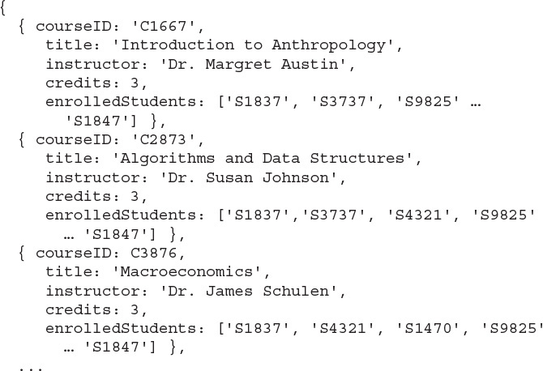
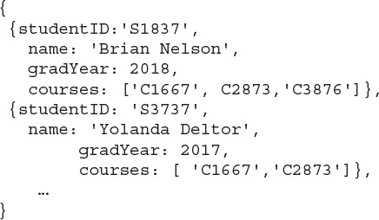
Many to Many Relations
Still uses embedded documents/data
Duplicated information
Remember there are no constraints enforced
  You must enforce them

Slide 18
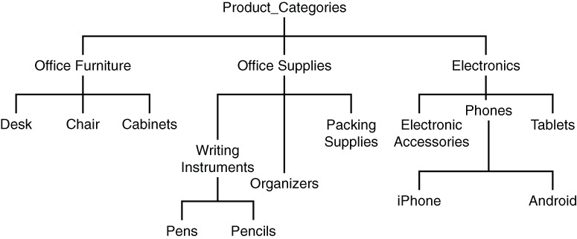
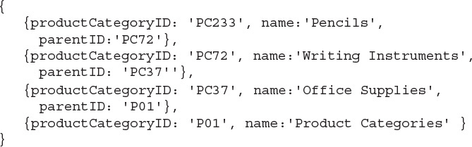
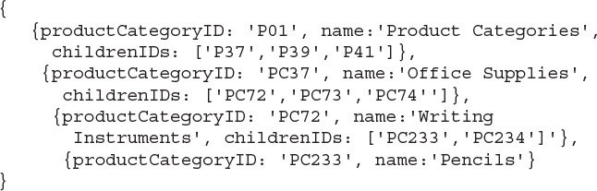
Modeling Hierarchies
Use document references or document ids
Your application will have to do the join
Parent ID’s
List of Children ID’s
Depending on queries, you could keep more info
  Full ancestor list, etc.

Slide 19
Designing for Document Databases
Consider use cases
  User stories
Consider the design patterns
Let your queries be your guide!
  Denormalize where needed
  Embed data where needed

Slide 20
MongoDB
Basic operations

Slide 21
What is MongoDB?
The name
  Mongo is derived from Humongous
  To say that MongoDB can handle a humongous amount of data
Document database
  In mongo you store documents
    Each document is identified by a key
      (key, document)
  Documents are written using BSON
    BSON is an extension of JSON (JavaScript Object Notation)

Slide 22
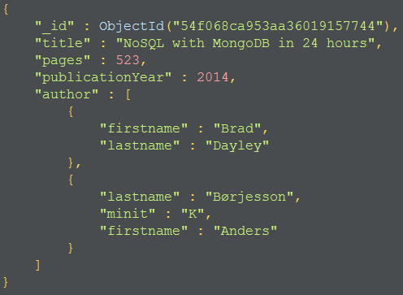
Example BSON document
{ …. }
  Curly braces encloses a document
Name : value Field
  Names are optionally quoted
_id
  The object id
  Automatically generated
[ … ]
  Array of documents / objects.
  Heterogeneous array
    May contain documents of different types

Slide 23
Some BSON data types
Double
String
Object
Array
Binary data
Object id
Boolean
  True or False
Null
Integer, 32 bit
Integer, 64 bit
Date
  64 bit Integer
  Number of milliseconds since Jan 1, 1970
    Unix birthday!
  Date() is now
  ISODate(”2012-07-05T01:45:20+01:00”)
    +01 is distrance from UTC/GMT
    http://en.wikipedia.org/wiki/ISO_8601
Regular expression
JavaScript
Reference
  http://docs.mongodb.org/manual/reference/bson-types/

Slide 24
The ObjectId data type
12 bytes, often written using hexadecimal [0-9a-f]
  4 bytes timestamp (time for object creation)
  3 bytes machine identifier
  2 bytes process identifier
  3 byte counter
Reference
  http://docs.mongodb.org/manual/reference/object-id/

Slide 25
MongoDB terms
Database
  Holds of a set of collections
  Each database has a name
Collection
  Holds a set of documents.
  Dynamic schema / heterogeneous collection
    A collection can hold documents with different structures
  Each collection has a name
Document
  A set of (key, value) pairs
  Each document has an ObjectId

Slide 26
Capped collections
Capped collection
  Fixed size
  Full: Make room for new document, by overwriting the oldest document
    Like circular buffer
    Insertion order is preserved
  Usage example: Log
  Creation
    Db.createCollection(”log”, {capped: true, size:10000, max:1000} );
  Source
    http://docs.mongodb.org/manual/core/capped-collections/

Slide 27
Atomic write operations
Relational DBMS has transactions
  ACID properties
MongoDB has atomic write operations
  Only one process can update a single document at the same time
  Updating a document + a referenced document is two writes
    Not atomic

Slide 28
Terms, MongoDB vs. Relational DBMS
MongoDB | Relational DBMS
Collection | Table
BSON document | Row
BSON field | Column
Index | Index
Embedded document | Join
Shard | Partition
Shard key | Partition key

Slide 29
Query language / API
Find documents in a collection
  db.books.find(…)
Save documents to a collection
  Db.collection.save(…)
  Db.collection.insert(…)
Update documents in a collection
  Db.collection.update(…)
Remove documents from a collection
  Db.collection.remove(…)

Slide 30
Save(…) vs. insert(…)
Db.collection.save(document)
  Saves a document to the collection.
Example, without _id
  db.books.save( {
  title: "Beginning Android 4",
  pages : 531
  });
  The DBMS create a value for the _id field
Example, with _id
  db.books.save( {
  _id : 123,
  title: "Oracle PL/SQL Programming"
  });
  If the _id:123 exists the new document will replace the old document
Source
  http://docs.mongodb.org/manual/reference/method/db.collection.save/
Db.collection.insert(document)
  Inserts a document into the collection
Example, without _id
  db.books.insert( {
  title: "Oracle PL/SQL Programming"
  });
  The DBMS create a value for the _id field
Example, with _id
  db.books.insert( {
  _id: 123,
  title: "Mastering Oracle SQL"
  });
  If the _id:123 exists the new document will be rejected.
    … duplicate key error …
Source
  http://docs.mongodb.org/manual/reference/method/db.collection.insert/

Slide 31
Update(…)
Update one or more documents in a collection
  … or replace document(s)
General syntax
  Db.collection.update(query, update, options)
  Query: selection criteria for the update
    Which documents are updated
  Update: The updates to apply
Source
  http://docs.mongodb.org/manual/reference/method/db.collection.update/
Example
  db.books.update(
  { title: "Beginning Android 4“ },
  {
  title: "Beginning Android 4 Apps",
  publisher: "Wrox"
  },
  {
  upsert: false // no match, no update
  }
  );

Slide 32
Remove(…)
General syntax
  Db.collections.remove(query, justOne)
  Query: Query: selection criteria for the update
    Which documents will be removed
  justOne: Boolean
    One or more documents to be removed
    Optional. Default false
Example
  db.books.remove( {
  title: "Mastering Oracle SQL"
  } )
Source
  http://docs.mongodb.org/manual/reference/method/db.collection.remove/

Slide 33
find(…)
General syntax: db.collection.find(criteria, projection)
  Criteria: optional
    Selection criteria: Which documents do you want to get
  Projection: optional
    Projections operators: Which fields of the documents do you want to get
  SQL analogy: SELECT projection FROM table WHERE selection
Find all documents
  Db.collection.find()
Find with criteria
  db.books.find({ publicationYear: 2014 });
    Books where the publicationYear fields has the value 2014
  db.books.find({ pages: { $gt: 25 } });
    Books where the pages field has a value greater than 25
Source
  http://docs.mongodb.org/manual/reference/method/db.collection.find/

Slide 34
Find(…) with and + or
Find(…) with and criteria
  db.books.find({publicationYear: 2015, title: /^Mongo/})
  publicationYear = 2015 AND title starts with (^) Mongo
    /^Mongo/ is a regular expression
Find(…) with or criteria
  db.books.find({$or: [ {publicationYear: 2015}, {title: /^Mongo/}]})
  publicationYear = 2015 OR title starts with Mongo
  $or: [ … array of conditions … ]
  db.books.find({$or: [ {publicationYear: 2015}, {publicationYear: {$exists: false}}]})
Find(…) with and criteria (a little more …)
  $and: [ … array of conditions … ]
    Find({cond, cond, .. }) works the same
    However with $and: you can use the same attribute more than once
  db.books.find({$and: [{publicationYear: {$ne:2014}}, {publicationYear: {$exists: true}}]})
    publicationYear exists, but is not equal ($ne) to 2014

Slide 35
Find(…), getting into sub-documents
Use the dot (.) operator to get into sub-documents
db.books.find({"author.firstname" : "John"});
  Documents with an author with the first name John
  Note: Author is an array
  Note 2: The name of the field (author.firstname) must be quoted
db.books.find( {$or: [ {"author.firstname" : "John"}, {"author.firstname" : "Brad"} ] } );

Slide 36
find(…), projections
Include fields
  db.books.find({}, {title: 1, publisher: 1});
  {} no selection = all documents
  Title, publisher (and _id) included in the output
Exclude fields
  db.books.find({}, {title: 0});
  All fields, but title, in the output

Slide 37
Find() with sort(), limit(), and skip()
The output can be sorted
  db.books.find().sort({title: 1, publicationYear: 1});
    Sort by 1. title, 2. publicationYear
The output can be limited
  db.books.find().sort({title: 1}).limit(4);
  Only the first 4 documents are included in the output
You can skip parts of the output
  db.books.find().sort({title: 1}).skip(2).limit(3);
  Two documents are skipped.
  Next 3 documents are included in the output

Slide 38
Counting documents
You can count the number of documents in a collection
db.books.count()
  Counts all documents in the books collection
db.books.count({title: /Mongo/});
  Counts all document where the title contains “Mongo”
Source
  http://docs.mongodb.org/manual/reference/method/db.collection.count/

Slide 39
Distinct values
Getting all the values of arrays in a collection
db.books.distinct("author.firstname")
  All first names, from all books.
  Distinct, means no duplicates
Can be combined with sorting
  db.books.distinct("author.firstname").sort();

